Slide 1
EMI and EMC Standards
For PCB manufacturing
-117EC0034
117EC0037
117EC0035
117EC0022

Slide 2
Introduction
The regulations regarding electromagnetic compatibility (EMC) can affect many aspects of circuit and system design. However, there are many considerations that can be applied generally to reduce both the emissions from and susceptibility to electromagnetic interference (EMI).
Our design should be capable of minimizing emissions and committed to achieve EMC compliance by correct component choice and design. For this every design shall be complied with the list of general design considerations.

Slide 3
EMC is associated with the generation, propagation, and reception of electro-magnetic energy — not exactly a welcomed character in a PCB design. That energy results due to a mixed combination of energy producers and care must be taken to make sure such signals are compatible and do not interfere with each other when it is necessary that different circuits, traces, vias, and PCB materials operate in unison.
EMI, on the other hand, are the unwanted, damaging effects EMC or the undesirable energy generates. In such an electromagnetic environment, the PCB designer’s goal is to assure that various energy elements are reduced to maintain minimal interfering effects.

Slide 4
Electro Magnetic Compatibility
From a designer’s point of view, EMC phenomena have to be considered in two
different ways:
• How the environment may affect the design(susceptibility)EMS.
• How the design may affect the environment(interference)EMI.
Traditionally, the only government regulations have been on the emission side:
An electronic device is not allowed to emit more than a certain amount of radio
frequency energy to avoid disturbing radio communication or operation of other
electronic equipment.
Most countries in the world have regulations on this topic
E M I + E M S = E M C

Slide 5
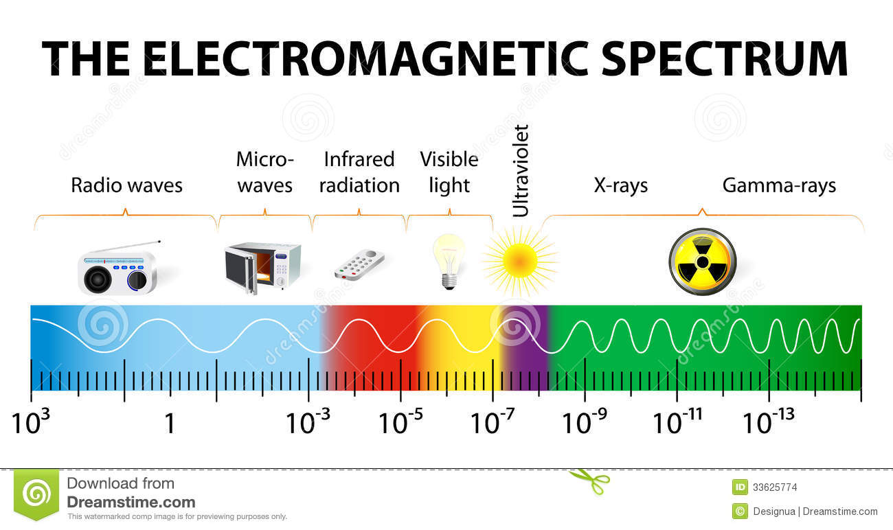
Domain of EMI/EMC
10kHz - 40GHz

Slide 6
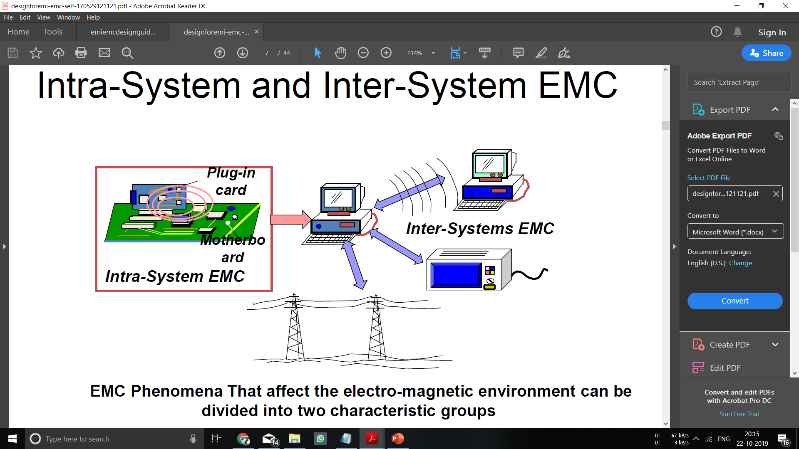

Slide 7
EMC Phenomena –
That affect the electro-magnetic environment can be divided into two characteristic groups
● Transient Interference Sources
● Continuous Interference Sources

Slide 8
EMC FUNDAMENTALS
The coupling path is frequency dependent
✓ High frequencies are radiated
✓ Low frequencies are conducted
✓ The boundary is typically about 30 MHz
There are 5 aspects to EMC when finding the problem
✓ Frequency - Where in the spectrum is the problem observed?
✓ Amplitude - How strong is the energy source?
✓ Time - Is it continuous or intermittent with operation?
✓ Impedance - What is the Z of the source and receiver?
✓ Dimensions - What are the physical dimensions of the device which will
allow emissions? (RF currents will leave through openings which are
fractions of a wavelength!)

Slide 9
How PCB’s Radiate RF Energy
• Digital signals with fast rise/fall times contain very high frequency components even for low clock frequencies! Fmax = 1/π tr
• The RF currents from the switching choose the low impedance path
• The Z0 of air is about 377Ω
• Discontinuities in the RF return path ZRF>> 377Ω.
• RF current leaves the board in favor of the air = EMI

Slide 10
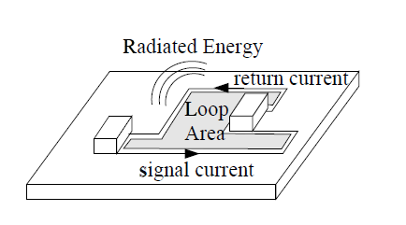
Radiated emissions

Slide 11
Power Supply considerations
• Eliminate loops in supply lines (see figure ).
• Decouple supply lines at local boundaries
(use RCL filters with low Q, see figure ).

Slide 12
Place high speed sections close to the power line input, slowest section furthest away (reduces power plane transients, see Figure
Isolate individual systems where possible (especially analogue and digital systems) on both power supply and signal lines (see figure ).

Slide 13
Signal line consideration
• Track all signals on the board, avoid
‘flying leads’ across the board.
• Minimize rise and fall times on signal
and clock edges (sharp edges produce wide
hf spectra), slew rate limiting also reduces
crosstalk (see figure ).

Slide 14
PCB Considerations
• Avoid slit apertures in PCB layout, particularly in ground planes or near current paths.
• Areas of high impedance give rise to high EMI, use wide tracks for power lines on the trace side.
• Make signal tracks strip line and include a ground plane and power plane whenever possible.
• Keep HF and RF tracks as short as possible, lay out the HF tracks first (see figure ).
• Avoid track stubs, these cause reflection and harmonics (see figure).

Slide 15
• On sensitive components and terminations use surrounding guard ring and ground fill where possible (see figure ).
• A guard ring around trace layers reduces emission out of the board, only connect to ground at single point and make no other use of the guard ring (i.e. do not use to carry ground return from a circuit).
• A guard ring around trace layers reduces emission out of the board, only connect to ground at single point and make no other use of the guard ring (i.e. do not use to carry ground return from a circuit).

Slide 16
Component Selection
Isolated DC-DC Converters
• An isolated DC-DC converter can provide a significant benefit to reducing susceptibility and conducted emission due to isolating both power rail and ground from the system supply. Isolated DC-DC converters are switching devices and as such have a characteristic switching frequency which may need some additional care and filtering.
Segregation of components
• Components need to be segregated with functionality – Analog, Digital, high speed digital, RF and so on. The tracks for each group should stay in their designated area. For a signal to flow from one subsystem to another, a filter should be used at subsystem boundaries

Slide 17
RF Sources for EMI/EMC
• Noise in Micro computer Chips- traces acts as antenna
• I/O Pins of digital ICs- traces acts as antenna
• Power Supply: Switching harmonics. Traces
• Oscillator circuits:
• Loops and Dipoles

Slide 18
General
Digital Circuits
• When dealing with digital circuits, extra attention must be given to clocks and other high speed signals. Traces connecting such signals should be kept as short as possible and be adjacent to the ground plane to keep radiation and crosstalk under control. With such signals, engineers should avoid using Vias or routing traces on the PCB edge or near connectors. These signals must also be kept away from the power plane since they are capable of inducing noise on the power plane as well. While routing traces for an oscillator, apart from ground no other trace should run in parallel or below the oscillator or its traces. The crystal should also be kept close to the appropriate chips.
Clock Termination
• Traces carrying clock signals from a source to a device must have matching terminations because whenever there is an impedance mismatch, a part of the signal gets reflected.If proper care is not provided to handle this reflected signal, large amount of energy will be radiated. There are multiple forms of effective termination, including source termination, end termination, AC termination, etc.
Analogue Circuits
• Traces carrying analog signals should be kept away from high-speed or switching signals and must always be guarded with a ground signal. A low pass filter should always be used to get rid of high-frequency noise coupled from surrounding analog traces. In addition, it is important that the ground plane of analog and digital subsystems not be shared.

Slide 19
EMI SUPPRESSION

Slide 20
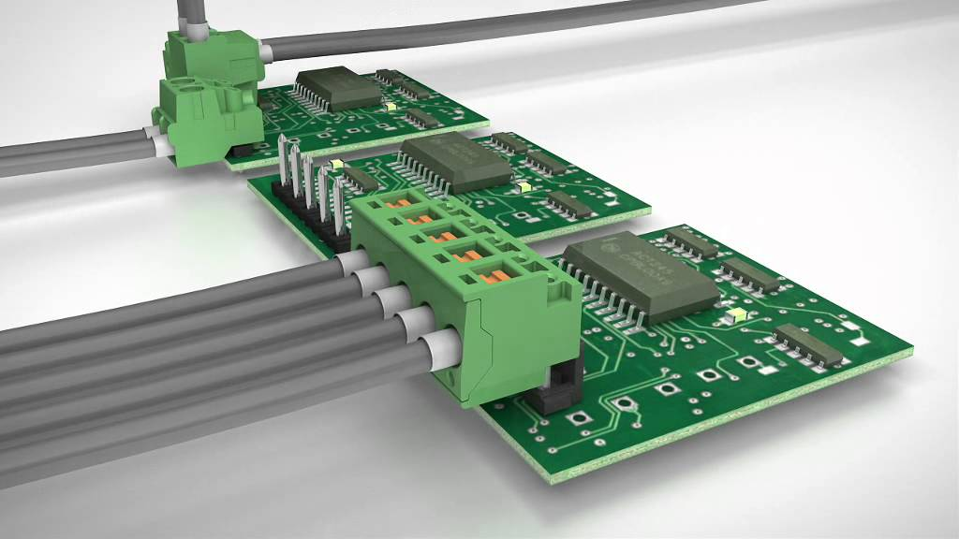
• Connectors should be located on one edge or on one corner of a board.
• A device on the board that communicates with a device off the board through a connector should be located as close as possible (e.g. within 2 cm) to that connector
• All off-board communication from a single device should be routed through the same connector.
• Components not connected to an I/O net should be located at least 2 cm away from I/O nets and connectors.
• Don’t locate circuitry between connectors
• Minimize signal current loop areas.
• Avoid sharp corners in traces

Slide 21
Grounding
Designing a PCB’s ground plane is the most important part of reducing EMI.
The first step is to increase the PCB’s ground area as much as possible within the board’s total area, which reduces emissions, crosstalk, and noise.
Care should be taken to connect each component to a ground point or plane.
A highly complex PCB design is characterized by several regulated voltages. Ideally, every reference voltage should possess its corresponding ground plane. However, an excessive number of ground planes could increase the PCB fabrication cost, making it overly expensive. A compromise measure is to split the ground planes at three to five different places, accommodating multiple ground sections in one ground layer. This keeps the cost of board fabrication cost in check while reducing EMI and EMC.

Slide 22
A low impedance ground system plays a big role in minimizing EMC.

Slide 23
Compartmentalize EMI
Because there are different segments to EMI, a good EMC design rule is to focus on analog and digital circuitry separately.
Analog circuits carry relatively high current and should be kept away from high-speed traces or switching signals
The digital signal should have a digital ground, and the analog signal should be terminated at an analog ground.
At high-speed levels, signals and clocks should be kept as short as possible and adjacent to the ground plane because the ground plane keeps crosstalk, noise, and radiation levels in check and within the acceptable level limits.
Digital signals should also be kept away from the power plane. If they’re close to it they can create noise or induction, thereby deteriorating the signal and weakening it.

Slide 24
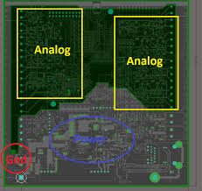

Slide 25
Crosstalk and traces
Traces are important to ensure that current is properly propagated.
Two high-speed signals running in parallel create EMC and EMI, such as crosstalk.
Hence the return current path should be kept as short as possible with the least resistive path.
Induced currents in a perfectly balanced, routing stable environment should cancel each other, thus eliminating crosstalk. However, this is not possible . Therefore, care must be taken to keep crosstalk on all the traces to as minimum a level as possible.
Crosstalk’s effect on adjacent traces can be minimized by keeping them at least twice the trace width apart. For example, if trace width is five mils, minimum distance between two parallel traces should be 10 mils or more.

Slide 26
Decoupling capacitors
Decoupling capacitors are used to reduce the undesirable effects of crosstalk.
These capacitors are placed between the power pin and ground pin of a device, which ensures low AC impedance to reduce noise and crosstalk.
To reach low impedance over a wide range of frequency, several decoupling capacitors should be used.
An important decoupling capacitor placement rule is to place the lowest value capacitor as close as possible to the device’s power pin or power trace and directly connect the capacitor’s pad to the via or ground plane.

Slide 27
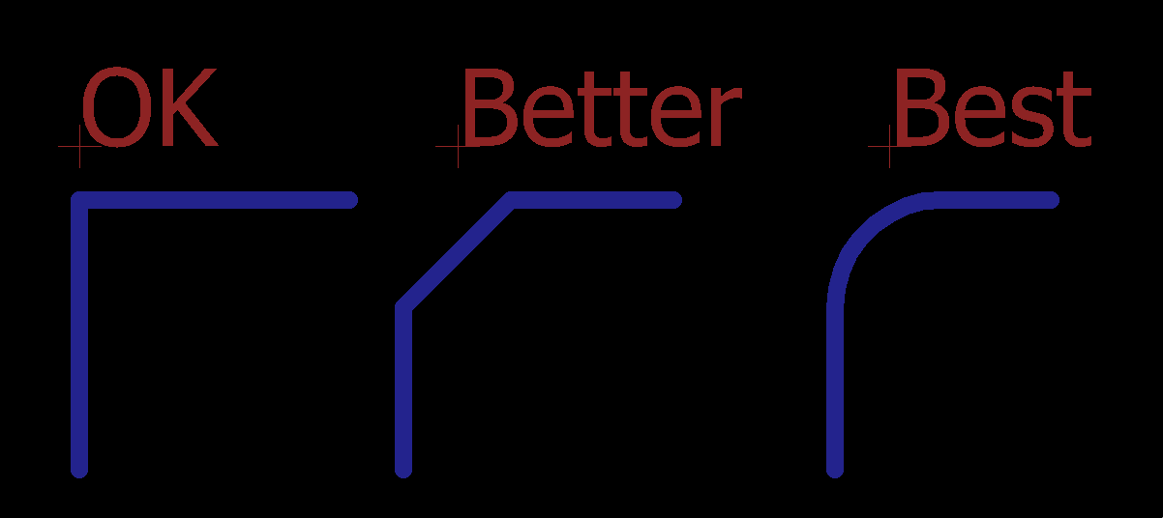
Avoid 90° angles
To reduce EMI it’s important to avoid 90° angles for traces, vias, and other components because right angles cause radiation
In such cases, capacitance increases in in that corner and characteristic impedance changes causing reflection, which in turn causes EMI interference.
To avoid 90° angles, traces should be routed at least on two 45° angles to the corners.

Slide 28
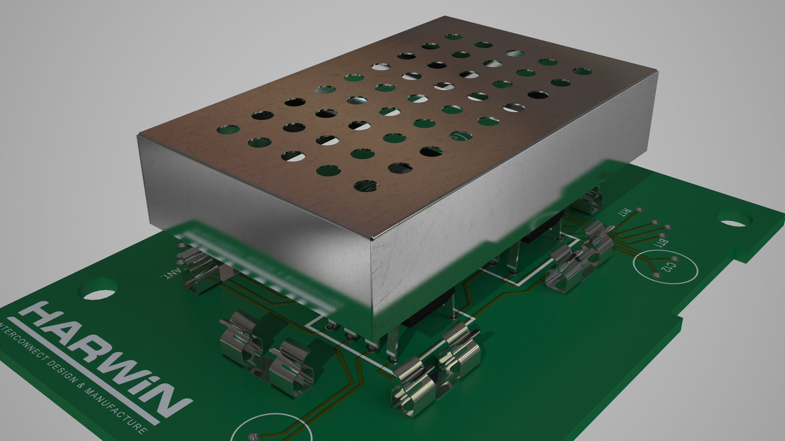
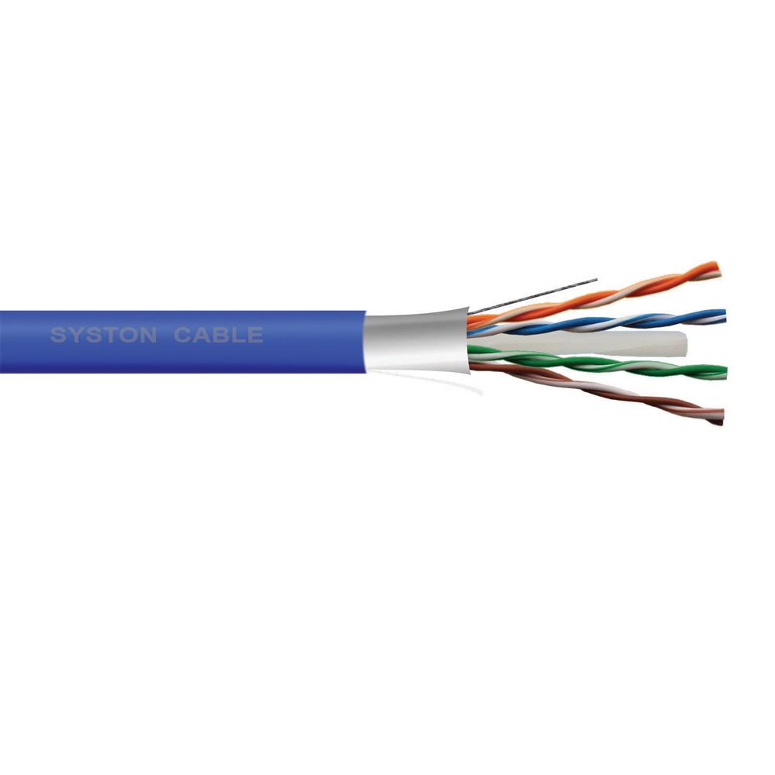
Cables and physical shields
Cables carrying digital circuits and analog currents cause most EMC-related issues by creating parasitic capacitance and inductance.
If twisted pair cable is used, it keeps coupling to a lower level and cancels any generated magnetic fields.
For high-frequency signals, a shielded cable is essential, connected to ground at the front and back, which cancels whatever EMI is present.
Physical shields are metallic packages that cover all or part of a system and play a major role in keeping EMI from entering into the PCB’s circuitry. Depending on design requirements, these shields act like closed conductive containers connected to ground they reduce antenna loop size and absorb EMI.

Slide 29
THANK YOU
- Group 8

